Slide 1
Introducing the sample nominations
NOM PPT 5.7
UNESCO
Intangible Cultural Heritage Section

Slide 2
The nomination form
Submitting State(s) Party(ies)
Name of element
Communities concerned
Geographical location and range
Domains
Identification and definition
Need for urgent safeguarding
Safeguarding measures
Community participation and consent
Inclusion in an inventory
Documentation
Signature of States Party

Slide 3
Other documentation required
Community consents
Proof of inventory
Photos and video
Cession of rights form

Slide 4
The sample nominations
Kijimana traditions and practices (Africa)
Procession of Hana (Eastern Europe)
Council of Irrigators (Western Europe)
Skills for Wooden bridge construction (Asia)
Fonabal music and singing (Latin America)
Making and ceremonial use of Kinjali swords (Arab states)

Slide 5
Kijimana traditions and practices
Africa

Slide 6
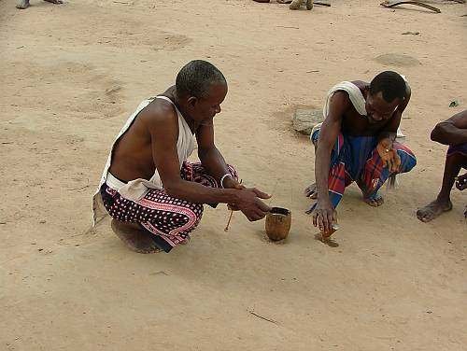
Pouring a libation

Slide 7
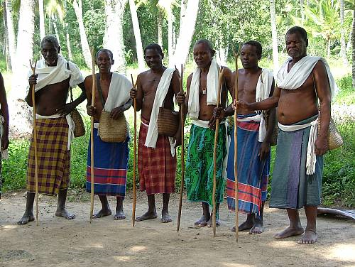
A council of elders

Slide 8
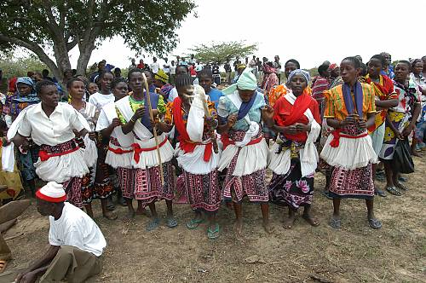
Women participating in a ritual

Slide 9
Procession of Hana
Eastern Europe

Slide 10
The procession preparing to go through the town

Slide 11
Visiting a family during the procession

Slide 12
Council of Irrigators
Western Europe

Slide 13
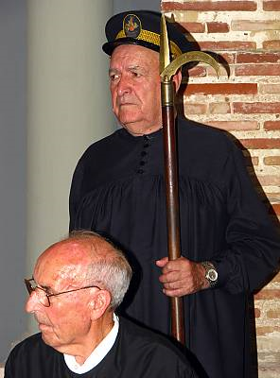
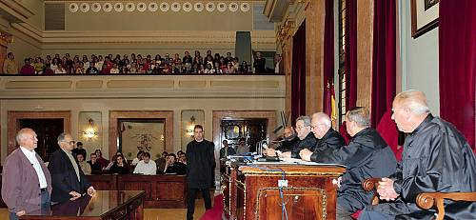
The Council meets in the Town Hall
Council members

Slide 14
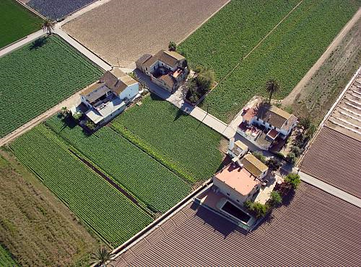
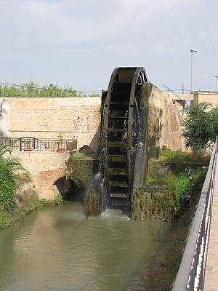
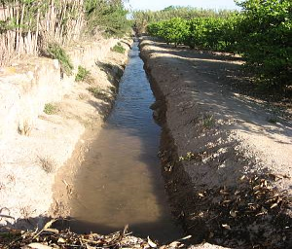
The canal system
Waterwheel on a canal

Slide 15
Skills for wooden bridge construction
Asia

Slide 16
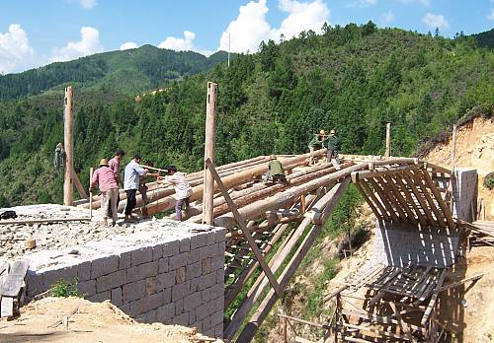
A bridge in construction

Slide 17
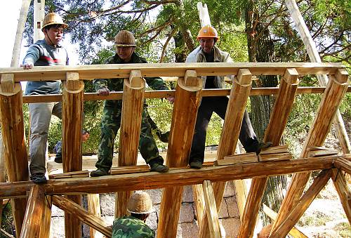
Detail of bridge showing mortise and tenon joints

Slide 18
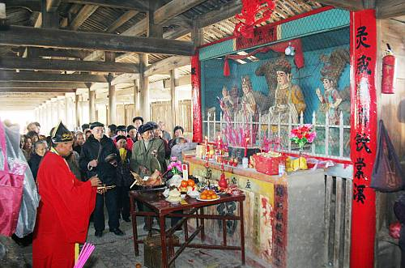
A shrine on a bridge

Slide 19
Fonabal Music and Singing
Latin America

Slide 20
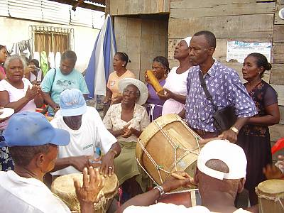
Fonabal music group

Slide 21
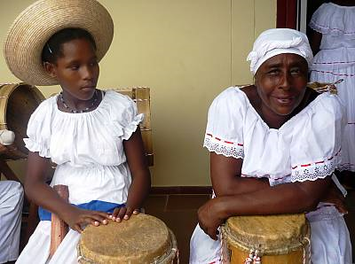
Singer and drummer with drums

Slide 22
Making and using the Kinjali sword
Arab states

